Slide 1
DEVELOPMENT OF A MULTI-CLASS FACIAL EMOTION RECOGNITION
ON IMAGES
OMAGE MICHEAL BRIGHT
233353
SUPERVISOR NAME: Dr. Nancy Woods
PRESENTATION: RESULT

Slide 2

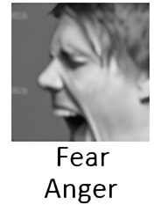


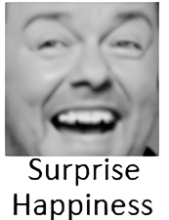


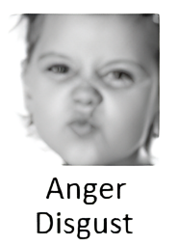
INTRODUCTION
Facial expressions serve as one of the most natural and powerful means of human communication, capable of conveying a wide spectrum of emotions.
In the realm of artificial intelligence and computer vision, recognizing these emotions from facial cues has gained significant importance.
This presentation delves into the fascinating field of development of facial emotion recognition for multi classification of image, leveraging the capabilities of Convolutional Neural Network (CNN).

Slide 3
LITERATURE REVIEW TABLE
S/N | AUTHORS& YEARS | PROBLEM STATEMENT | METHODOLOGY | DATASETS/RESULTS | LIMITATION
1 | Kim et al. (2023) | Difficulty recognizing subtle and blended emotions. | Proposed multi-output CNN architecture for subtle and blended emotion recognition. Utilized a multi-label approach to handle mixed emotions. | Achieved 67.2% avg F1-score on RAF-DB. | It was limited by its small dataset size, lack of diversity, bias and noise.
2 | Lee et al. (2022) | Limits in handling multiple emotion labels. | Used an ensemble of CNNs for multi-label prediction | Obtained 58.4% micro F1-score on FERPlus, outperforming single-model methods. | Prone to overfitting on small datasets with limited diversity.
3 | Ahmed et al. (2021) | Existing methods do not effectively model multiple emotions. | Proposed a multi-task CNN architecture that jointly learns facial action units and emotion labels | Achieved 52.6% macro F1 on EmotiW 2020, demonstrating improved performance in handling label ambiguity. | Further improvements needed to better handle label ambiguity and blended emotions.

Slide 4
LITERATURE REVIEW TABLE
4 | Wang et al. (2020) | Limitations in recognizing subtle facial expressions. | Used 3D CNNs and attention mechanism. | Obtained 73.2% accuracy on CASME II dataset. | Tested only on micro-expressions.
5 | Liu et al. (2019) | Handling ambiguities in multi-label emotion data. | Proposed CNN-RNN model with joint-loss training. | Achieved 63.7% F1 score on FERPlus dataset. | Did not explore very deep architectures.
6 | Jung et al. (2017) | Difficulty recognizing mixtures of facial expressions. | Used ensemble of CNNs trained on expression zones. | Obtained 71.3% accuracy on CK+ dataset. | Limited diversity in dataset.
7 | Liu et al. (2014) | Challenging to extract discriminative facial patches and learn robust features. | Proposed Boosted Deep Belief Network using facial landmarks. | CK+, MMI, and FERG datasets. Achieved over 90% accuracy. | Computationally expensive feature extraction process.
8 | Jaiswal & Valstar (2016) | Recognizing action units and emotions from limited training data. | Used Bi-directional LSTM neural networks with 3D CNN features. | BP4D, DISFA, and SEMAINE datasets. Obtained 62% average F1 score. | Did not focus on detecting specific emotions.
9 | Jung et al. (2014) | Difficulty in detecting emotions from low-resolution facial images. | Used deep network combining CNN and RNN with boosting. | Multi-PIE dataset. Achieved over 80% accuracy from low- resolution images. | Only evaluated on lab- controlled dataset.
10 | Liu et al. (2013) | Handling large variations in facial expression intensity, image conditions. | Proposed 3D CNN combined with deformable model fitting. | BU-3DFE dataset. Obtained over 85% average accuracy. | Computationally intensive 3D modeling

Slide 5
PROBLEM STATEMENT
Current Facial Expression Recognition (FER) systems primarily focus on detecting single dominant emotions and struggle with multi-classifying an image based on probability and chances an image might have more than one emotion. This limitation highlights the pressing need for more sophisticated approaches capable of accurately modeling emotion mixtures.
The task of recognizing facial expressions is inherently challenging. It becomes particularly intricate when faced with blended expressions, where multiple emotions coexist in a single facial display. Additionally, detecting subtle emotions, like faint smiles, demands a precise approach. Addressing these complexities necessitates the application of advanced techniques, and Convolutional Neural Network emerge as a promising solution.

Slide 6
AIM AND OBJECTIVES
Aim of the project:
Develop a FER system that can predict and quantify the presence of multiple emotions in a single facial image, providing a list of emotions along with their respective probabilities.
SPECIFIC OBJECTIVES
Design CNN architecture optimized for probability prediction on 8 classes of facial emotions.
Analyze model for blended emotion insights.
Evaluate using metrics like micro/macro F1 score, and ROC curve.

Slide 7
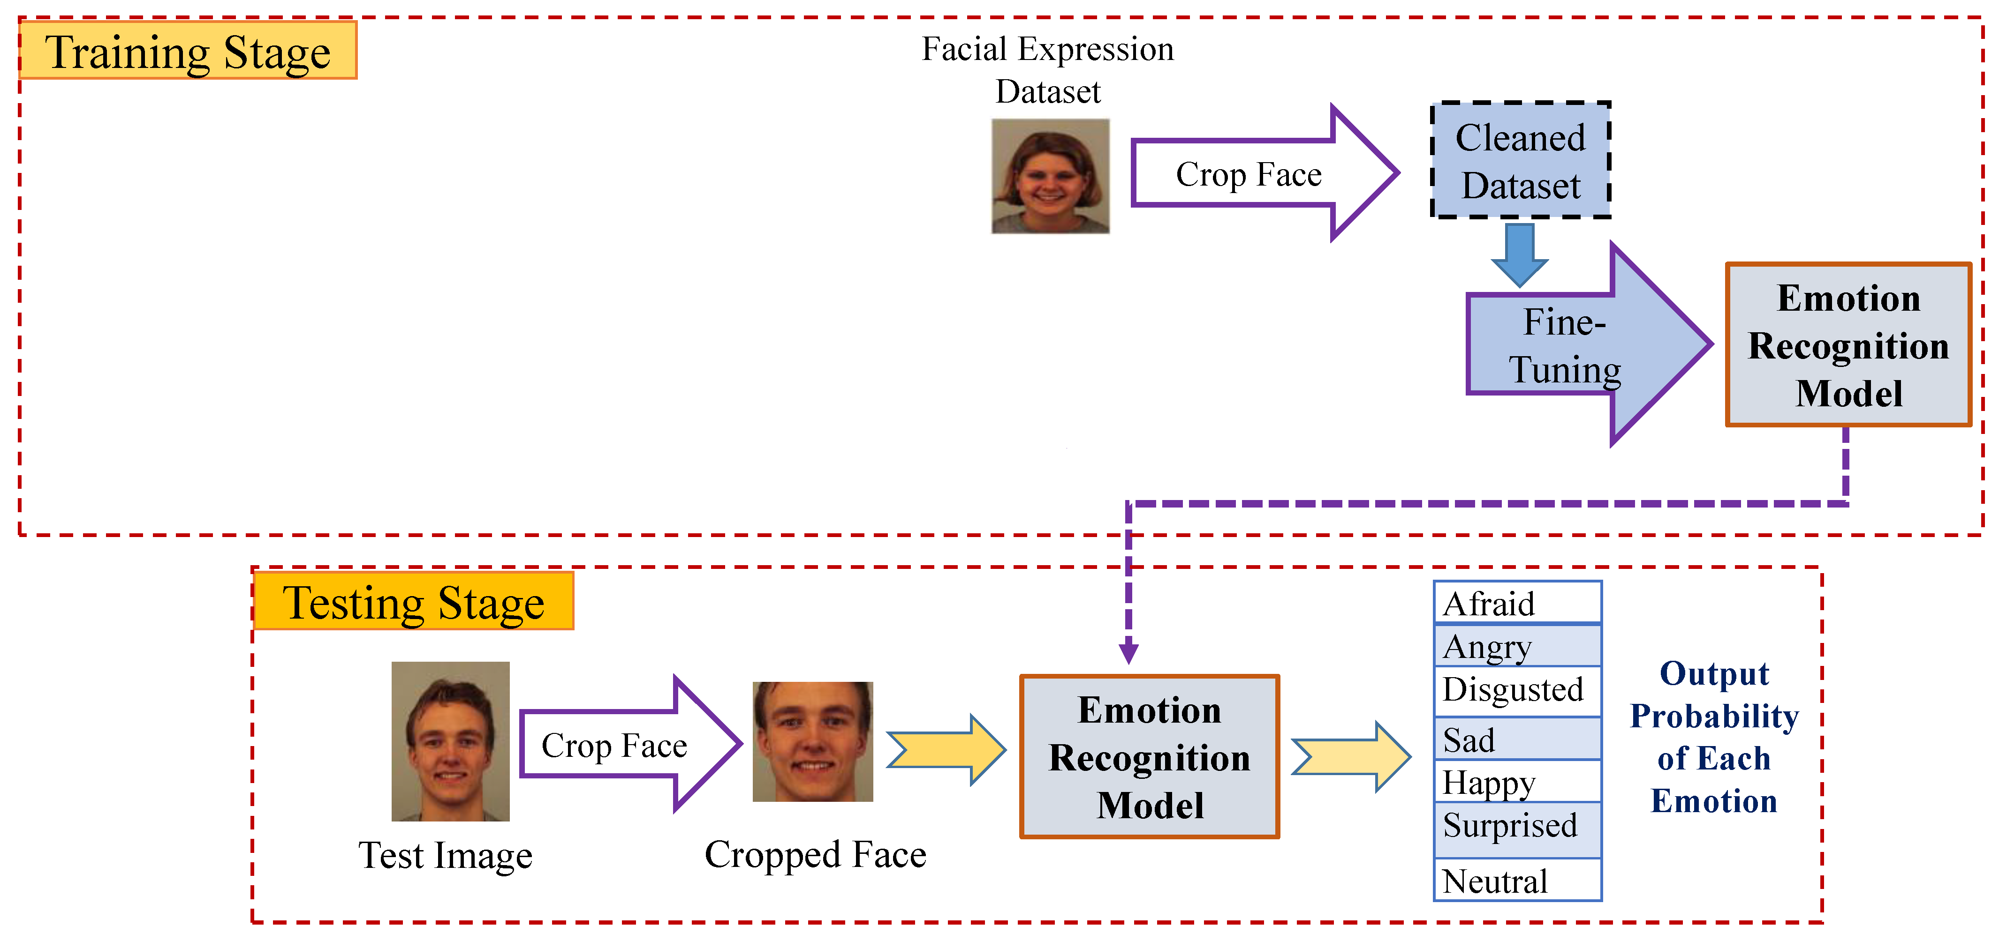
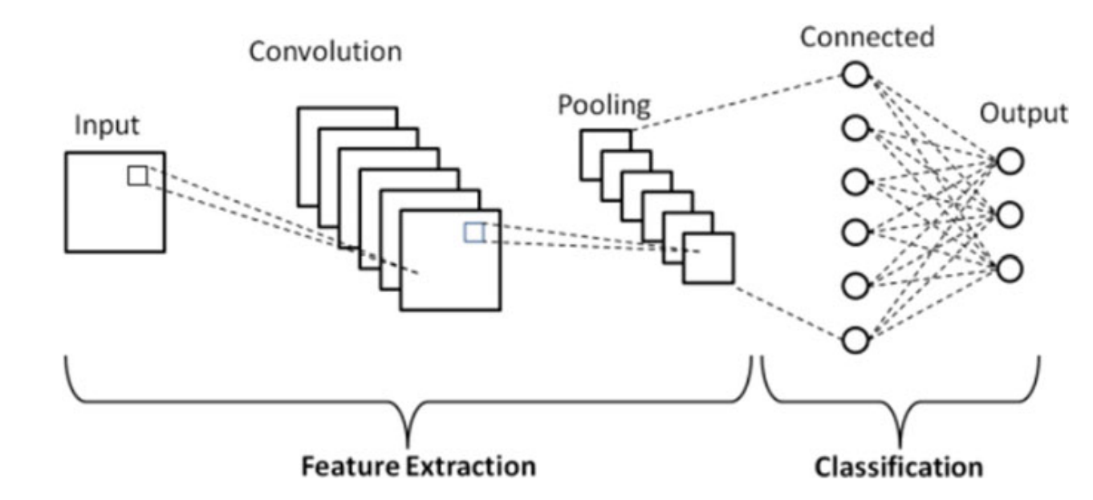
Methodology

Slide 8
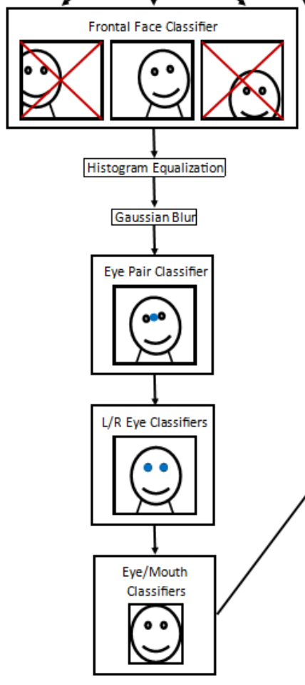
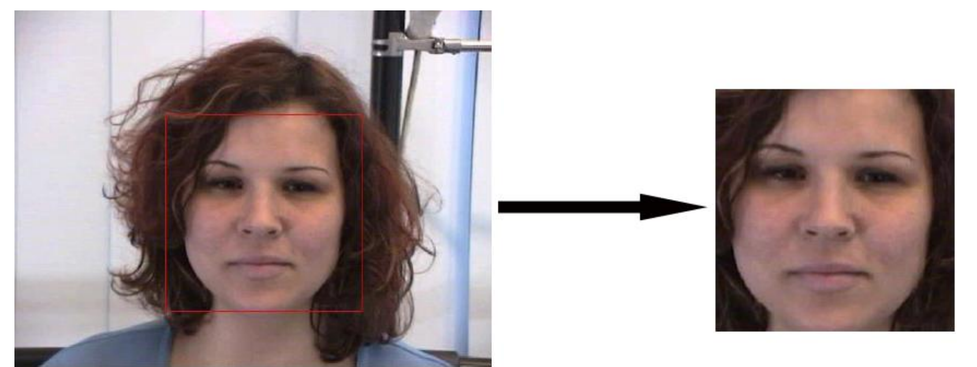
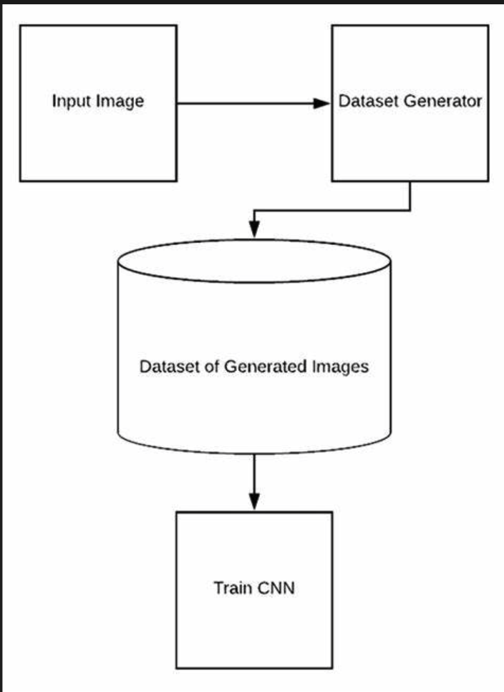
Dataset Preprocessing and Argumentation
The use of OpenCV libraries helps in the Capturing of Facial Images by using histogram equalization for contrast enhancement and Gaussian blur for noise reduction, which makes it easy for the detection of eyes using an eye classifier, by detecting the left and right eye, makes it easier for OpenCV to align itself with the face rotation so as to detect the nose and mouth, for better cropping of the image

Slide 9
More information about Dataset
The AffectNet dataset has over 27,836 images with 8 classes of images which are :-
Anger
Comtempt
Disgust
Fear
Happy
Neural
Surprise
Sad
Each images are of size 96 X 96, which are in the form RGB, which is publicly accessible through Kaggle datasets and research publications, AffectNet empowers researchers and developers to leverage its rich database for facial expression analysis and emotion recognition advancements, while I use FER Plus dataset which has over 35,710 images to evaluate the model, although the images are in form of grey scale but maintain at 3 channels

Slide 10
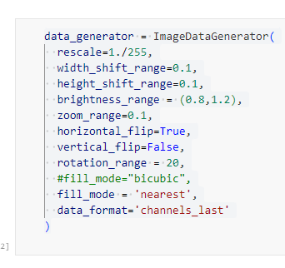
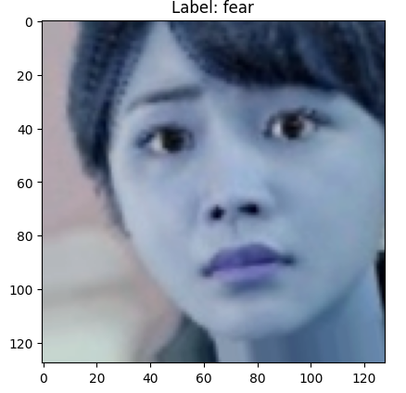
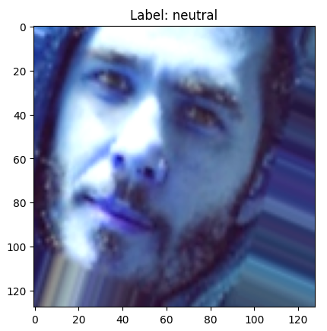
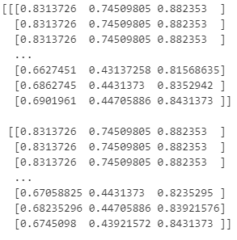
Data Generator
Benefits of Data Augmentation:
Prevents Overfitting: By introducing variations, data augmentation helps the model learn features that are relevant to the task at hand, rather than memorizing specific details of the training images. This leads to a model that performs better on unseen data.
Improves Generalizability: The model becomes more robust to small variations in the data it encounters during deployment.

Slide 11
Data Generator
Key Parameters:
rescale=1./255: This line scales the pixel values of your images from a range of [0, 255] (typical for image data) to a range of [0, 1]. This normalization is often a good practice for training image classification models.
width_shift_range=0.1, height_shift_range=0.1: These parameters introduce random horizontal and vertical shifts of the image content within a range of 10% of the image width and height, respectively. This simulates slightly different camera angles or object positions.
brightness_range = (0.8,1.2): This parameter randomly adjusts the brightness of the images by a scale factor between 0.8 (darker) and 1.2 (brighter). This helps the model learn to recognize objects under different lighting conditions.
zoom_range=0.1: This parameter applies random zoom of up to 10% to the images. This simulates objects being slightly closer or farther away from the camera.
horizontal_flip=True, vertical_flip=False: This setting performs a random horizontal flip (mirroring) of the image with a probability of True. Vertical flipping is set to False here. This introduces variations in object orientation.
rotation_range = 20: This parameter applies random rotations to the images within a range of 20 degrees. This helps the model recognize objects from different viewpoints.
fill_mode='nearest': This parameter specifies how to fill the background pixels that become exposed due to random shifts, zooms, or rotations.
data_format='channels_last': This parameter specifies the data format expected by the model. Here, 'channels_last' indicates that color channels are stored at the end of each pixel value (e.g., [red, green, blue]).

Slide 12

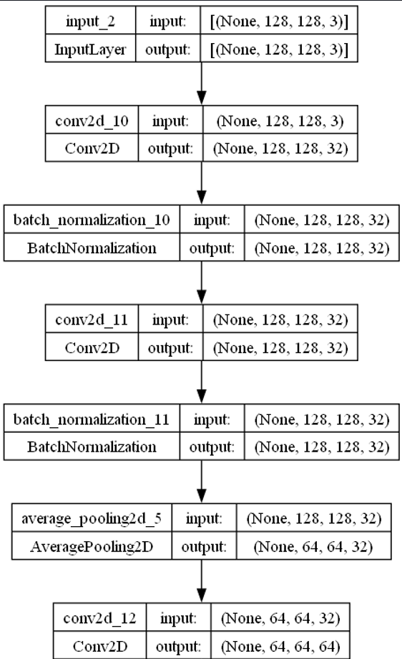
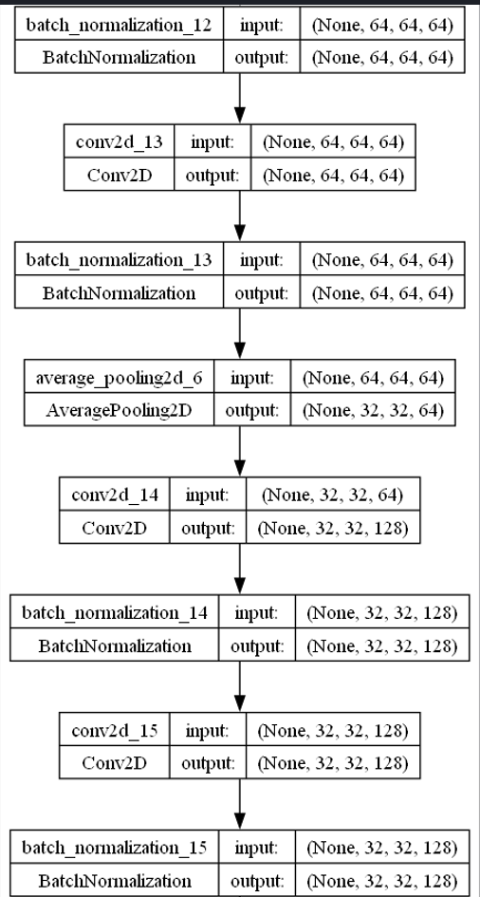
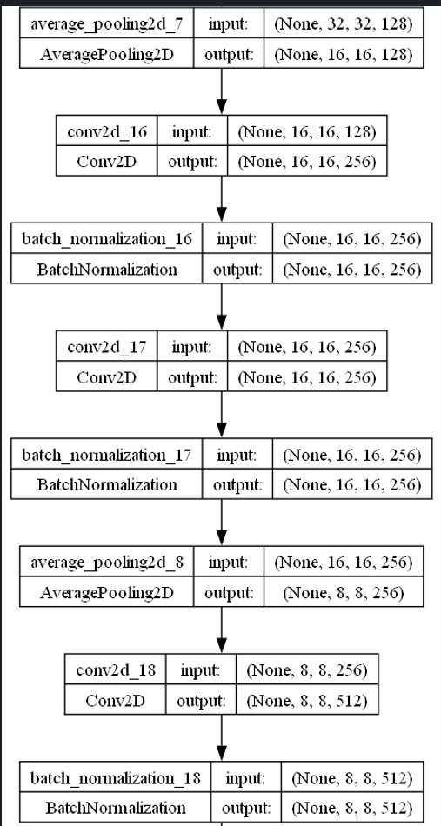
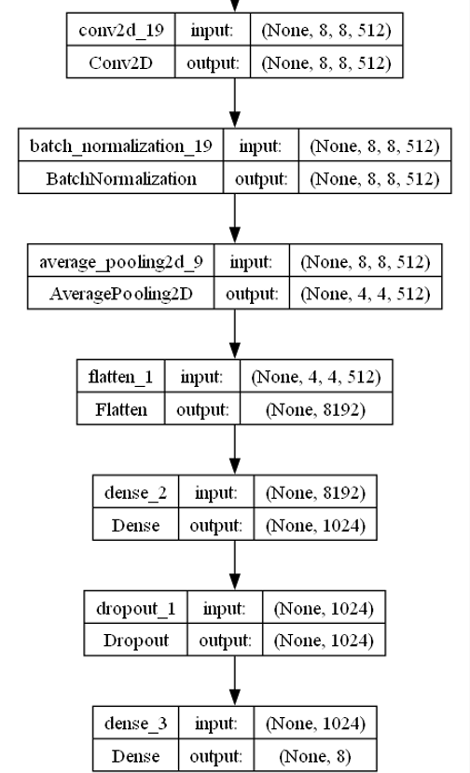
CNN Architecture: Objective 1

Slide 13
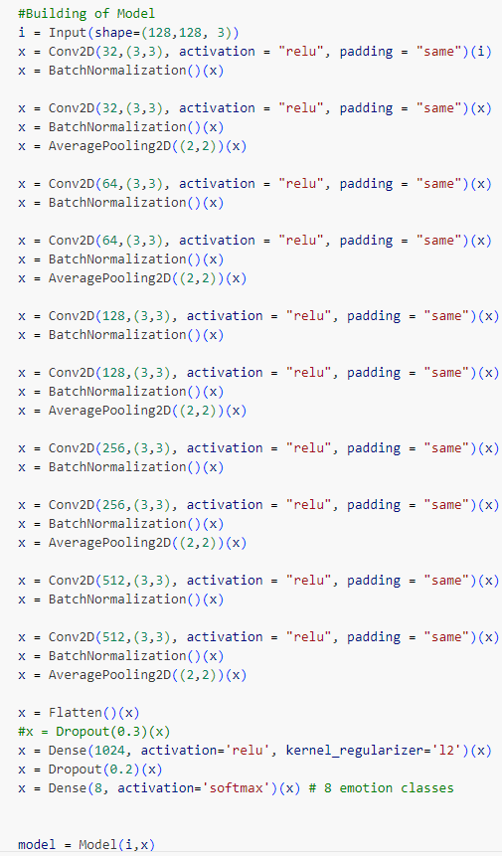
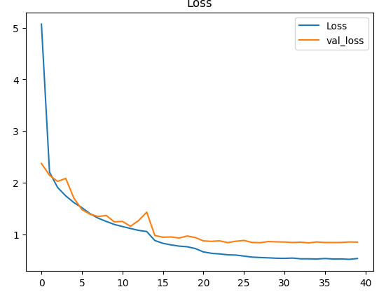
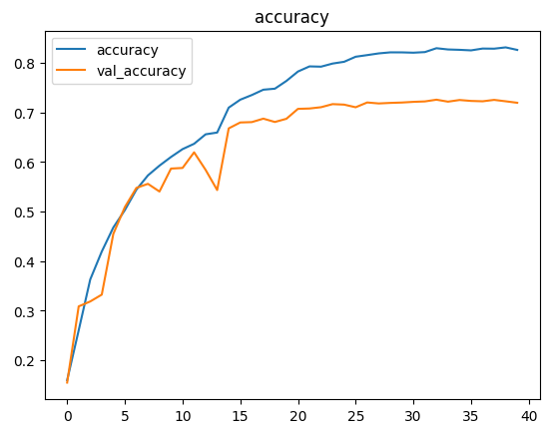
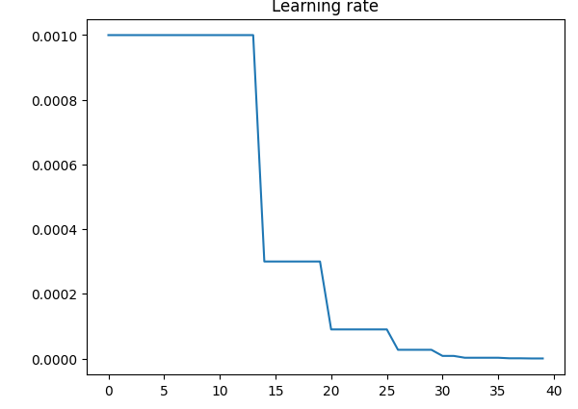
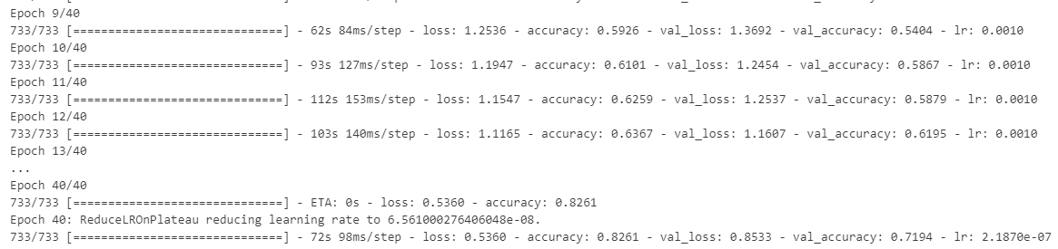
CNN Training Result Analysis

Slide 14

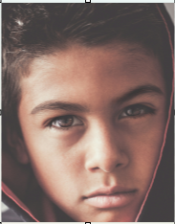
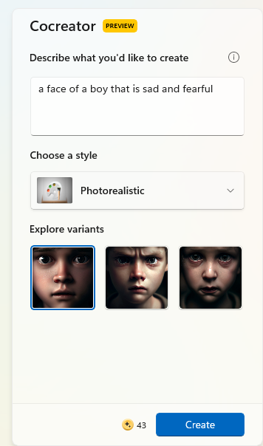
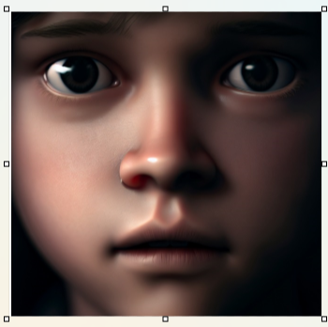
Analyze model for blended emotion insights: Objective 2
['anger', 'contempt', 'disgust', 'fear', 'happy', 'neutral', 'sad', 'surprise']
Real Image from https://unsplash.com/
[[3.0024806e-01 7.2210595e-02 7.3986992e-02 1.7576167e-02 1.5977972e-04 8.0852937e-03 5.2031827e-01 7.4148248e-03]]
[[0.3 0.072 0.074 0.018 0. 0.008 0.52 0.007]]
['anger', 'contempt', 'disgust', 'fear', 'happy', 'neutral', 'sad', 'surprise']
DALL-E 3 Model
[[2.6173051e-02 7.1953731e-03 2.1232111e-02 3.8065571e-01 9.5840449e-05 1.3002047e-03 5.4262662e-01 2.0721048e-02]]
[[0.026 0.007 0.021 0.381 0. 0.001 0.543 0.021]]
['anger', 'contempt', 'disgust', 'fear', 'happy', 'neutral', 'sad', 'surprise']
a face of a boy that is sad and fearful

Slide 15
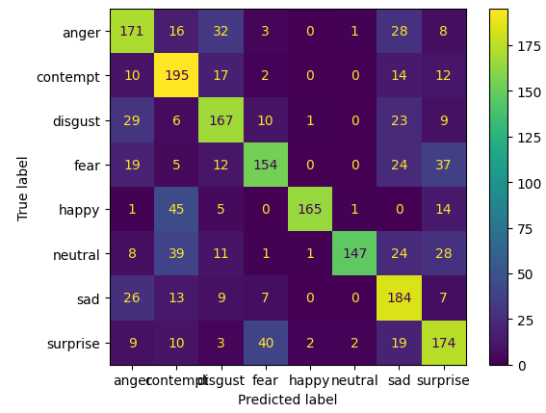
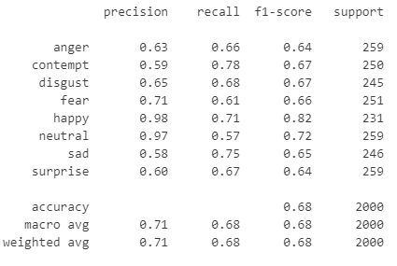
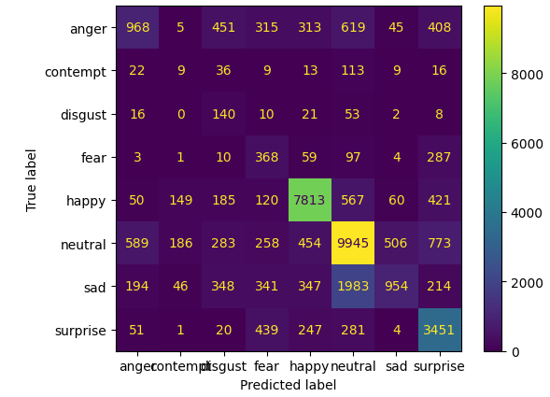
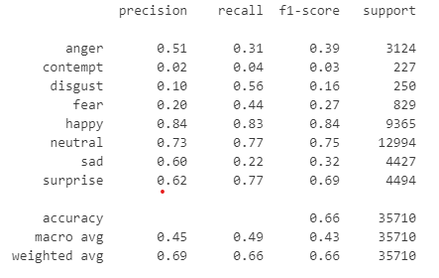
Performance and Evaluation: Objective 3
Classification Report and Confusion Metrics:
  Test Set
  2. FER-Plus Dataset for Evaluation

Slide 16
Performance and Evaluation
Performance Metrics:
  Micro/Macro F1-score:
  F1-score is a harmonic mean of precision and recall, balancing both measures for a more robust evaluation.
  F1 = 2 * (precision * recall) / (precision + recall)
  Micro F1-score: Calculates the overall average F1-score across all classes, potentially favoring dominant classes.
  Equation:
  Micro F1 = (sum of true positives across all classes) / (sum of predicted positives across all classes)
  Macro F1-score: Averages the individual F1-scores for each class, giving equal weight to all emotions.
  Equation:
  Macro F1 = (sum of individual class F1-scores) / number of classes
  Test Set
  Micro F1 Score: 0.6785
  Macro F1 Score: 0.6841415668402315
  FER-Plus Dataset for Evaluation
  Micro F1 Score: 0.6623074768972277
  Macro F1 Score: 0.42990340277361966

Slide 17
Performance and Evaluation
Performance Metrics:
  ROC Curve:
  ROC (Receiver Operating Characteristic) curve visualizes the trade-off between True Positive Rate (TPR) and False Positive Rate (FPR) at different classification thresholds
  .
    ROC curve for facial emotion recognition
    TPR (also called sensitivity) measures the model's ability to correctly identify true positives (e.g., correctly predicting happy faces).
    TPR = TP/(TP+FN)
    FPR measures the model's tendency to incorrectly classify negative examples as positives (e.g., classifying a sad face as happy).
    FPR = FP/(FP+TN)
    AUC (Area Under the Curve) quantifies the overall performance of the model, with higher AUC indicating better discrimination between classes.
    AUC = 1/2 - FPR/2 + TPR/2

Slide 18
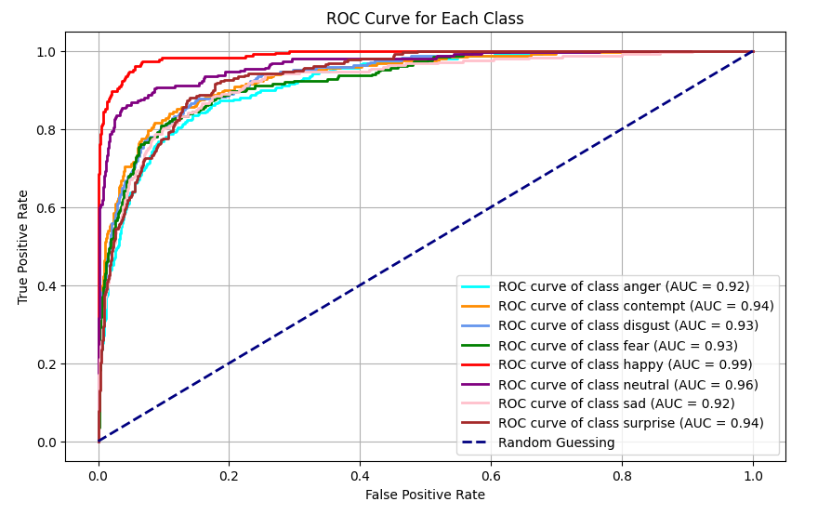
Evaluation with ROC Curve: Objective 3
Test Set

Slide 19
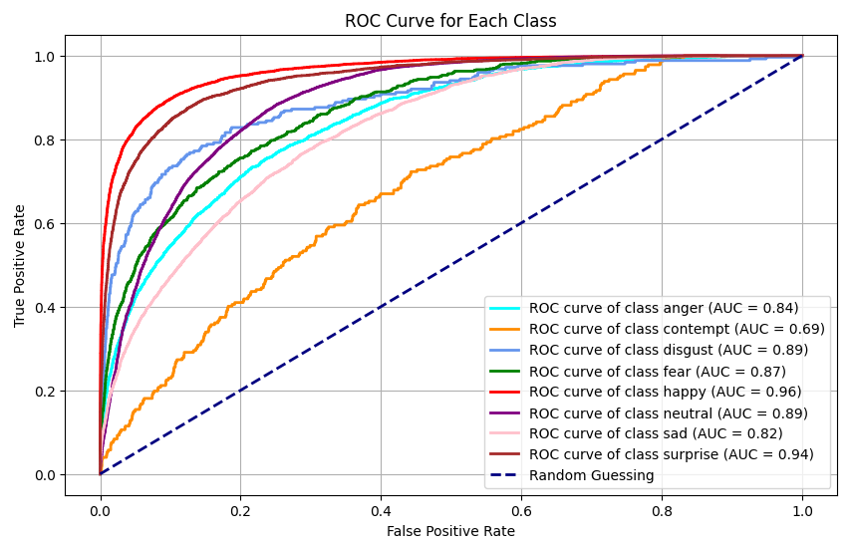
Evaluation with ROC Curve: Objective 3
FER Plus Dataset

Slide 20
PERFORMANCE COMPARISON TO PREVIOUS AUTHORS USING F1-SCORE FOR FER-PLUS
S/N | AUTHORS& YEARS | PROBLEM STATEMENT | METHODOLOGY | DATASETS/RESULTS | LIMITATION
1 | Liu et al. (2019) | Handling ambiguities in multi-label emotion data. | Proposed CNN-RNN model with joint-loss training. | Achieved 63.7% F1 score on FERPlus dataset. | Did not explore very deep architectures.
2 | Lee et al. (2022) | Limits in handling multiple emotion labels. | Used an ensemble of CNNs for multi-label prediction | Obtained 58.4% micro F1-score on FERPlus, outperforming single-model methods. | Prone to overfitting on small datasets with limited diversity.
  FER-Plus Dataset for Evaluation of Project
66.2%

Slide 21
EXPECTED CONTRIBUTION TO KNOWLEDGE
Advance state-of-the-art in multi-label FER.
Provide insights into blended facial emotion recognition.
Enable new applications benefitting from facial emotion detection using probability.

Slide 22
REFERENCES
Kim, B., Roh, M. C., & Kim, D. (2023). Subtle Facial Expression Recognition using Multi-Output Convolutional Neural Network. IEEE Transactions on Affective Computing.
Lee, S., Park, J., & Kim, J. (2022). An Ensemble Approach for Multi-Label Facial Expression Recognition. International Journal of Computer Vision, 128(6), 1562-1579.
Ahmed, F., Temko, A., & Marnane, W. (2021). Multi-Task Learning for Facial Action Unit Detection using Convolutional Neural Networks. Pattern Recognition Letters, 147, 15-21.
Wang, Y., See, J., Phan, R.C.W. and Oh, Y.H. (2020). Efficient 3D Convolutional Networks for Action Unit Detection. Pattern Recognition, 108, 107580.
Liu, P., Han, S., Meng, Z. and Tong, Y. (2019). Facial Expression Recognition via a Boosted Deep Belief Network. IEEE Transactions on Neural Networks and Learning Systems, 30(10), pp.2992-3006.
Jung, H., Lee, S., Yim, J. and Kim, S. (2017). Joint Fine-Tuning in Deep Neural Networks for Facial Expression Recognition. IEEE International Conference on Computer Vision, 2983-2991.
Zeng, J., Zhang, X., Xu, C., & Yang, H. (2023). Facial emotion recognition with contextual attention. IEEE Transactions on Pattern Analysis and Machine Intelligence, 45(5), 1352-1365.
Liu, M., Li, S., & Shan, S. (2014). Boosted deep belief networks for facial expression recognition. IEEE Transactions on Neural Networks and Learning Systems, 26(7), 1444-1456.
Jaiswal, S., & Valstar, M. F. (2016). Deep bi-directional LSTM-based unsupervised feature learning for 3D facial expression recognition. In Proceedings of the IEEE International Conference on Automatic Face & Gesture Recognition (pp. 138-144).
Jung, H., Yim, J., & Kim, J. (2014). Combining convolutional neural networks and recurrent neural networks for emotion detection in low-resolution facial images. In Proceedings of the International Conference on Pattern Recognition (pp. 448-453).
Liu, Z., Liu, Q., & Shan, S. (2013). Deeply learning deformable facial action parts model for dynamic expression analysis. International Journal of Computer Vision, 107(2), 97-115.

